Slide 1
Pointer Recap

Slide 2
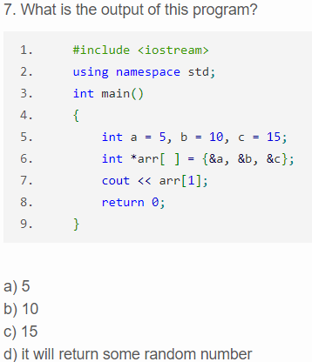

Slide 3
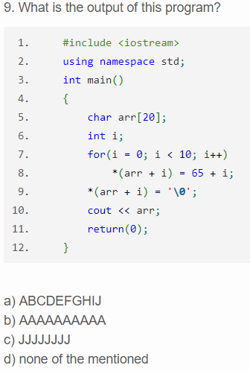

Slide 4
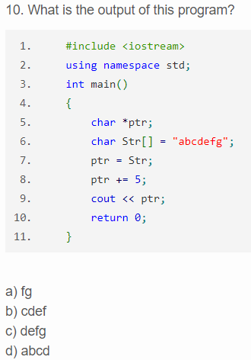

Slide 5
Algorithm Analysis

Slide 6
How can we compare different algorithms?
Compare time requirements
How much time will it take to execute the algorithm?
Compare space requirements
How much extra space is required for this algorithm to execute?

Slide 7
Benchmarks can be used to compute the time required to execute an algorithm
However, this has some key drawbacks:
An algorithm might run faster on one machine versus another (think AMD vs Intel; AMD vs Nvidia; Xbox vs PS; Windows vs Mac; etc.).
The selected inputs for a given run of the algorithm might not be a representative sample.
It takes a lot of time to maintain a set of benchmarks.

Slide 8
Sample "find" benchmark given the list {3, 9, 1, 2, 3, 5}
We would expect Find(3) to execute faster than Find(5)
Which is more representative?
How is our benchmark affected if we decide to use different values in our list or we want to alter the number of items in the list?

Slide 9
Benchmarks are great for telling us how an algorithm will execute under a given set of circumstances, but we ideally want something a bit more generalizable.

Slide 10
Algorithm Analysis is a mathematical technique for estimating the rate at which execution time grows relative to input parameters.
Algorithm analysis' more formal name is "asymptotic analysis"
Asymptotic analysis is a method of estimation that groups algorithms based on their growth rate.
Asymptotic analysis in unable to tell us for sure how one algorithm will perform relative to another (but it does give us some pretty good hints)

Slide 11
When we analyze an algorithm, we are often most concerned about worst case growth rate.
It's great to have a positive disposition, but as scientists and engineers, we need to know worst-case behavior so that we can plan accordingly.
Worst-case analysis is called "Big O" (pronounced "Big Oh") analysis
Big-O analysis categorizes algorithms based on their growth rate.

Slide 12
O(1) operations (also called constant time operations) are known to execute in a certain amount of time. Examples include:
my_array[50]
int my_int = 3;
sum = my_int + 5;
product = my_int * 50;
int foo = new int;
if(my_int == 3)

Slide 13
In Big O analysis, we are interested the maximum number of operations required to complete an algorithm.
How many operations are required to execute the following code?
if(answer == 'n')
{
cout << "Thanks for playing!" << endl;
}
return 0;

Slide 14
In Big O analysis, we are interested the maximum number of operations required to complete an algorithm.
How many operations are required to execute the following code?
if(answer == 'n')
{
cout << "Thanks for playing!" << endl;
}
return 0;
O(1) to make the comparison
Even though we only will call cout when the answer is 'n', we always count it because in we are concerned with the worst case
O(1) to return

Slide 15
The previous slide's algorithm would be O(3), but here's the rub:
For any O(X) where X = number of constant time operations, if there exists a constant k such that k*1 >= X, we reduce to O(1)
Therefore, O(3) = O(1)
This is true for O(100), O(1,000), O(10,000), and so on…

Slide 16
From the previous slide, we can infer that Big-O analysis is sometimes inaccurate when considering raw execution times.
According to Big-O analysis, the following two pieces of code are treated the same:
Segment #1:
int i = 0;
Segment #2:
for(int j = 0; j < 1000000; j++)
{
cout << "Hello";
}
Notes:
What does this say about Big-O analysis?

Slide 17
When performing Big-O analysis, we care about how the number of constant time operations is affected by various aspects of an algorithm.
Going back to our list: {3, 9, 1, 2, 3, 5}
Again, because we're doing Big-O analysis, we want to always find the last item because that would probably require the most amount of time.
Performing a Find(5) is directly affected by the size of the list.
Consider which Find(5) would be faster:
{3, 9, 1, 2, 3, 5} or {3, 9, 1, 2, 3, 1, 1, 1, 1, 1, 1, 1, 1, 1, 1, 5}
Notes:
6 comparisons vs 16 comparisons

Slide 18
Q: How many constant time operations are required to perform our find?
A: it depends.
Q: Depends on what?
A: It depends on the number of items in our list.
Q: How do we represent a list whose size can vary.
A: With a variable!

Slide 19
Our simple find algorithm is said to be O(n).
Let n represent the number of elements in our list. As n changes, so does the number of operations to be executed.
This relationship is linear. Therefore, the growth rate (i.e. Big-O) is also linear. We denote a linear relationship with the variable n.
If it helps, think of Big-O like an equation. O(n) is like y = x.

Slide 20
Simple FOR and WHILE loops are typically O(N)
FOR loops:
for(int i = 0; i < num_items; i++);
WHILE loops:
while(keep_going == 'y');

Slide 21
We often get larger than O(n) when we combine loops:
for(int i = 0; i < num_items; i++)
{
for(int j = 0; j < num_items; j++)
{
swap(items[i], items[j])
}
}
In this case, we multiply the effect that num_items has on the growth rate, yielding O(n^2)
Notes:
Talk about summation rules?

Slide 22
When loops are unrelated, we add rather than multiply. The following example is O(n + n) or O(2n):
for(int i = 0; i < num_items; i++)
{
cout << "hello";
}
for(int j = 0; j < num_items; j++)
{
cout << "goodbye";
}

Slide 23
We also perform reductions on non-constant time.
In Big-O analysis, we always drop coefficients. As such:
O(2n) -> O(n)
O(40n) -> O(n)
O(1000000n) -> O(n)
This is because Big-O cares about placing algorithms into performance classifications.

Slide 24
Common Big-O classifications / growth rates:
n! (factorial)
(exponential)
, d > 3 (polynomial)
(cubic)
(quadratic)
n * log(n) (no fancy name)
n (linear)
(root n)
log(n) (logarithmic)
1 (constant)

Slide 25
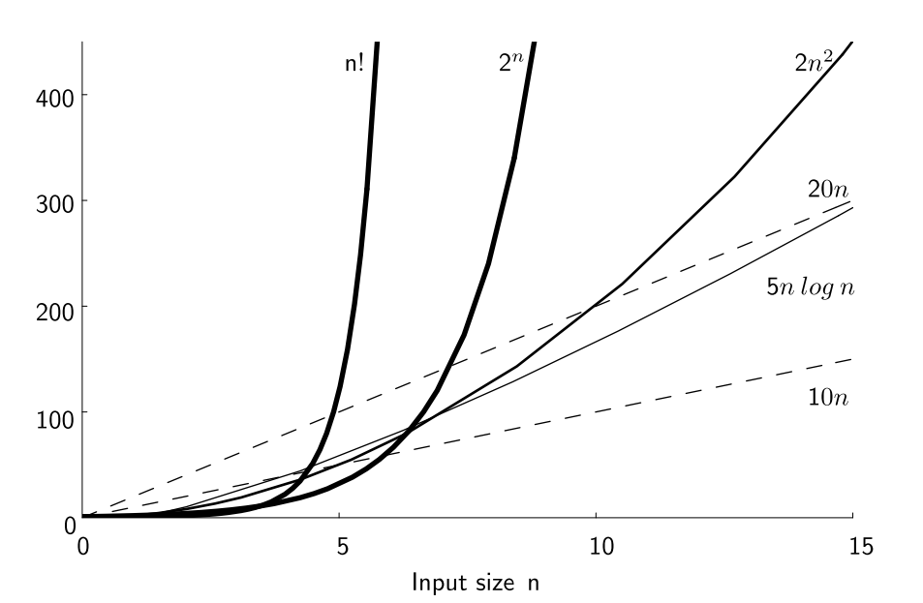
Here's a graph of the growth rates of some of these classifications:
Notes:
Note that the constants don't really matter in the long run. Also, use the graph to illustrate the reason behind dropping coefficients from Big-O

Slide 26
We obtain Log(n) growth rate whenever we can ignore roughly half of our input for each loop / function call.
Example #1:
for(int i = 0; i < num_items; i *= 2)
Example #2:
Binary search on a sorted list: {1, 2, 3, 4, 5, 6, 7, 8, 9, 10}

Slide 27
Sometimes, we get compound results. Example:
Algorithm that finds a given number and then prints out all numbers to the left of that number:
int numbers[] = {1, 2, 3, 4, 5, 6, 7, 8, 9, 10}
int item_index = binary_search(numbers, 5)
for(int i = 0; I < item_index; i++)
{
cout << numbers[i] << endl;
}

Slide 28
Sometimes, we get compound results. Example:
Algorithm that finds a given number and then prints out all numbers to the left of that number:
int numbers[] = {1, 2, 3, 4, 5, 6, 7, 8, 9, 10}
int item_index = binary_search(numbers, 5)
for(int i = 0; I < item_index; i++)
{
cout << numbers[i] << endl;
}
Binary search is Log(n)
This algorithm is O(Log(n) + n/2)
…or is it?
For finding 5, we will loop n/2 times

Slide 29
The previous algorithm was O(Log(n) + n/2). It can be reduced!
n/2 is a differs from n by a constant amount, so we get rid of the divisor. This results in:
O(Log(n) + n)
However, we're still not done!

Slide 30
The previous algorithm was O(Log(n) + n/2). It can be reduced!
n/2 is a differs from n by a constant amount, so we get rid of the divisor. This results in:
O(Log(n) + n)
y = Log(n) has a slower growth rate when compared to y = n. If we were to take the limit of both, we would see that y = n reaches infinity much faster than y = Log(n). Therefore, we can get rid of Log(n) from our Big-O analysis. This yields our final result of:
O(n)

Slide 31
Class Exercise
sum1 = 0;
for (i=1; i<=n; i++)
for (j=1; j<=n; j++)
sum1++;
O(1)
O(LogN)
O(N)
D. O(NLogN)
E. O(N^2)
F. O(2^N)
G. O(N!)
Notes:
O(n^2)

Slide 32
Class Exercise
sum1 = 0;
for (i=1; i<=n; i++)
for (j=1; j<=i; j++)
sum1++;
O(1)
O(LogN)
O(N)
D. O(NLogN)
E. O(N^2)
F. O(2^N)
G. O(N!)
Notes:
O(n * (1/2) * n) = O(1/2 N^2) = O(N^2)

Slide 33
Class Exercise
sum = 0;
for (i=1; i<=n; i++)
for (j=1; j<=i; j++)
sum++;
for (k=0; k<n; k++)
A[k] = k;
O(1)
O(LogN)
O(N)
D. O(NLogN)
E. O(N^2)
F. O(2^N)
G. O(N!)
Notes:
O(N^2 + N) = O(N^2)

Slide 34
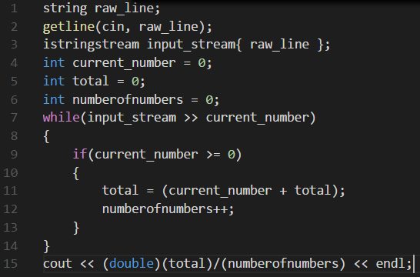
O(1)
O(LogN)
O(N)
D. O(NLogN)
E. O(N^2)
F. O(2^N)
G. O(N!)

Slide 35
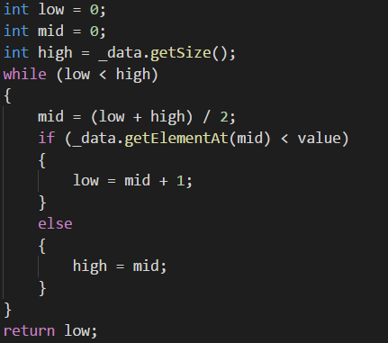
O(1)
O(LogN)
O(N)
D. O(NLogN)
E. O(N^2)
F. O(2^N)
G. O(N!)

